Slide 1

Coding Lesson 1
Output, Input and Variables
Elementary Coaches Academy

Slide 2
Log into your Scratch account
https://scratch.mit.edu

Slide 3

Warm up
Open the starter File
http://bit.ly/BYTEC1
Run the program by clicking the flag icon

Slide 4
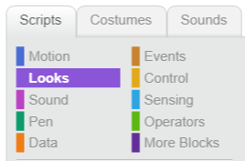
Warm up
Click the Looks menu
Add a command to make the cat say Goodbye

Slide 5
Warm up
Click the Looks menu
Add a command to make the cat say Goodbye

Slide 6
Warm up
Change the program to say:
Hello [your name]!

Slide 7
Definition: Output
A way to get information out of a computer.
What examples of output did we see in this program?

Slide 8

Lab Lecture
Click the sensing menu
Add a question to your program

Slide 9
Definition: Input
A way to give information to a computer.
What examples of input did we see in this program?

Slide 10
Lab Lecture
Change your program so it:
Asks the user for their name
Prints “Hi there [name]”

Slide 11
Lab Lecture
What if you want to:
Ask for the user’s first name, then ask for their last name and say:
Hi Ada Lovelace!
Notes:
Show them how to create a variable in the data menu

Slide 12
Definition: Variable
A placeholder for a piece of information that can change.

Slide 13
Rules for Variable Names
can use letters & numbers but no spaces
must start with a letter
describe what it holds

Slide 14
Practice Exercises
http://bit.ly/2GL3Qqj
Mild - perfect for beginners
Medium - expanding your skills
Spicy - looking for a challenge?

Slide 15
Journal
How does the computer science content in this lesson relate to topics you already teach?

